Slide 1


Slide 2
eSpeed Electronic Trading Interface
Message Flow Diagrams

Slide 3
Proprietary Rights Notice
This material contains proprietary and confidential information that is the exclusive property of eSpeed Inc., and is protected by copyright. All rights are reserved. No part of this document may be photocopied, reproduced or transmitted, in any form, or by any means, electronic, mechanical, or otherwise, or in connection with any information storage or retrieval system, or translated into another language without the prior written consent of eSpeed Inc.

Slide 4
Overview
Each Slide details the messages that pass between an eSpeed enabled application and the eSpeed system for various activities
Messages sent from the client are highlighted in RED
Messages received from the eSpeed system are highlighted in BLUE
Pre-existing States are highlighted in BLACK

Slide 5
Process Diagrams
Submitting a Bid/Offer
Canceling a Bid/Offer
Submitting a Buy/Sell Order
Bid/Offer Gets Hit/Lifted
Canceling a Buy/Sell Order
Market Data Subscribe/Unsubscribe
Queries

Slide 6
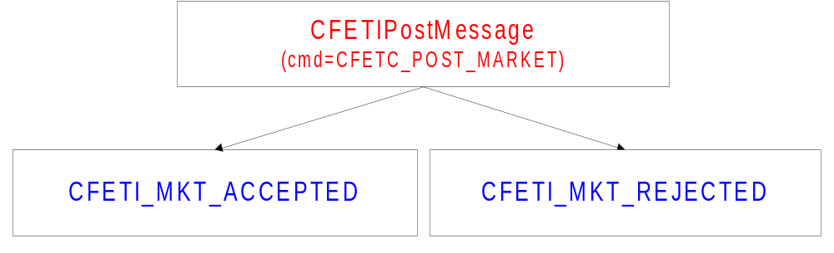
Submitting a Bid/Offer
Note:
When an outstanding bid is joined by a new best offer (or vice versa), a timer limits the ability of any market participant to hit (lift) except for the outstanding bidder and the new offerer (or vice versa). This market is exclusive to the outstanding and new market makers until the timer expires.

Slide 7
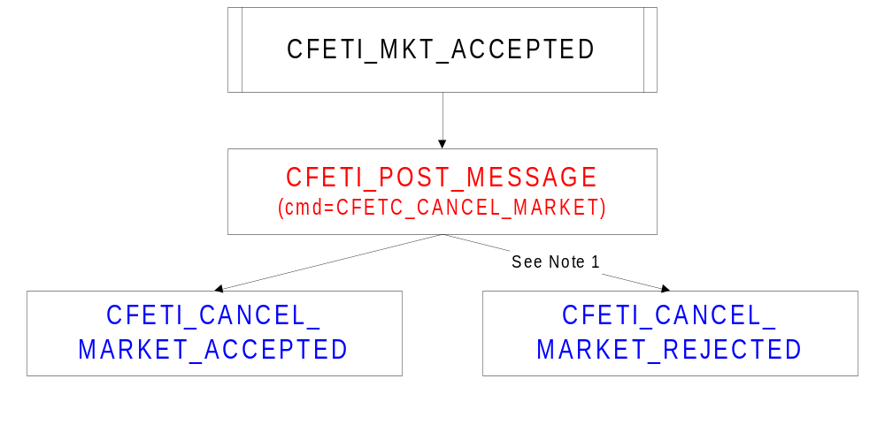
Canceling a Bid/Offer
Notes:
1. Certain products require a system defined interval to expire before a market can be cancelled.
2. A market can also be cancelled automatically by logging out, losing a connection to the trading system, a partial buy/sell (see Submitting a Buy/Sell Order) or by entering a better bid/offer (unless the outstanding bid/offer is a GTC or Limit )

Slide 8
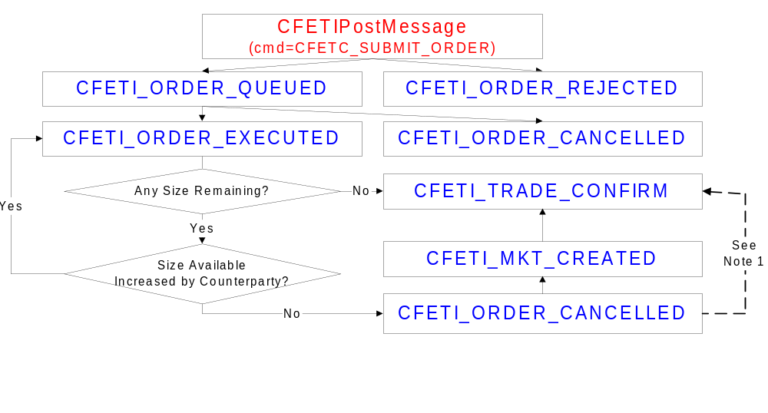
Submitting a Buy/Sell Order
Notes:
1. User account settings determine whether CFETI_ORDER_CANCELLED is followed by CFETI_MKT_CREATED
2. Trade execution is managed by three timers. The first timer allows the initial counterparties to have the exclusive right to increase their size and get matched. The second one passes this right to the other parties in the market. The third timer clears the trade and ends the hit/take state. Additionally, some systems use a timer to prevent trading for a cool off period after the initial trade clears.

Slide 9
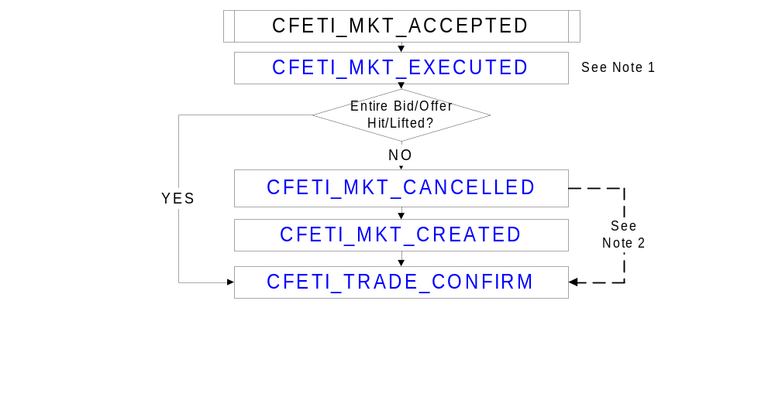
Bid/Offer Gets Hit/Lifted
Notes:
1. More than one CFETI_MKT_EXECUTED may occur for any given CFETI_MKT_ACCEPTED
2. User account settings determine whether CFETI_MKT_CANCELLED is followed by CFETI_MKT_CREATED
3. Trade execution is managed by three timers. The first timer allows the initial counterparties to have the exclusive right to increase their size and get matched. The second one passes this right to the other parties in the market. The third timer clears the trade and ends the hit/take state. Additionally, some systems use a timer to prevent trading for a cool off period after the initial trade clears.

Slide 10
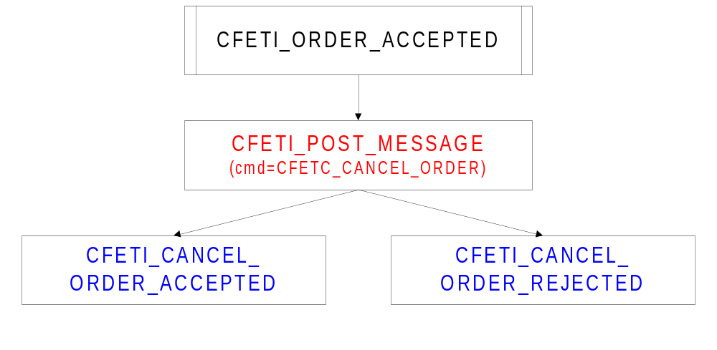
Canceling a Buy/Sell Order
Notes:
Users can only cancel the balance of the order that is not currently trading.

Slide 11
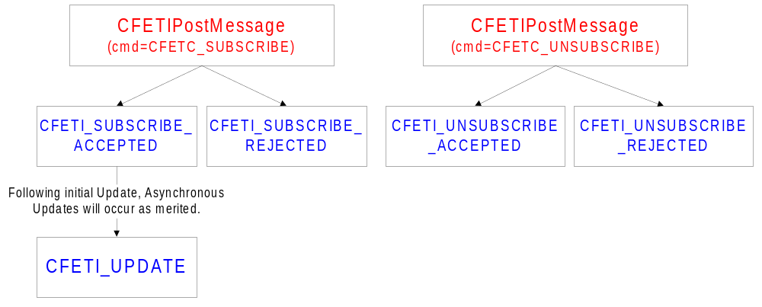
Market Data Subscribe/Unsubscribe
Note:
Subscribe to a security to begin receiving real time market data

Slide 12
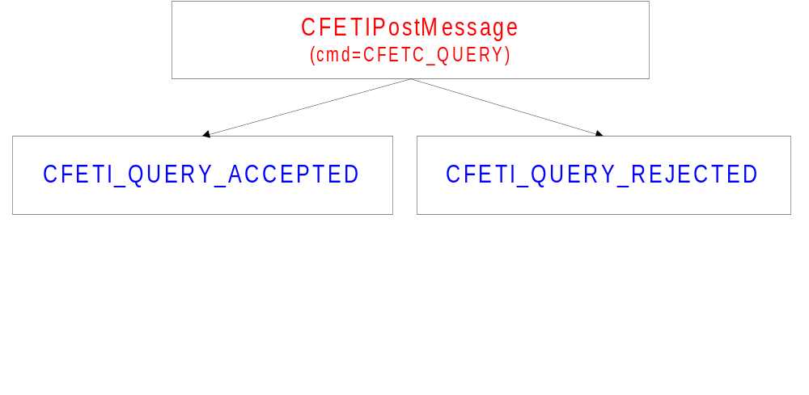
Queries
Note:
Instrument Query: Request data on tradable securities
Trade Query: Request data on trades executed by user

Slide 13
Further Information
For greater detail on any of the topics covered within this document, refer to the Electronic Trading Interface Reference Guide.

